Slide 1
Sustainability of Student Organizations
Green Office in collaboration with Wageningen University and Research

Slide 2
What will we do?
Warming up!
We’re all part of Wageningen UR
Survey results
Tips&Tricks
Your problems and possible solutions
Discussion

Slide 3
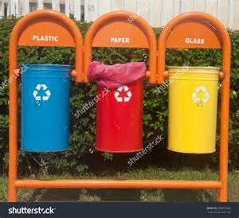
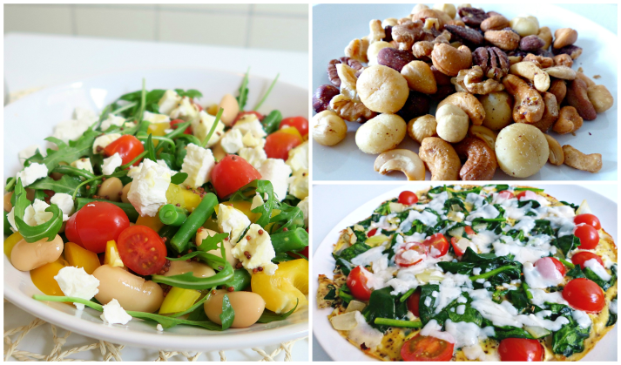
Warming up!
Who’s here?
Did everybody see the article? Their measures:
Energy-saving bar
Energy-saving heating

Slide 4
We’re all part of Wageningen UR!
3rd most sustainable University in the world!
SustainaBUL 4 times in a row
Movie – 60 seconds of sustainability
Mission and vision

Slide 5
Survey outcomes - Statistics
25 of the 34 associations responded
3 ‘green’ organizations
3 out of 4 big student associations
7 study associations
7 organizations ‘would like to know more’

Slide 6
Survey outcomes – positives

Slide 7
Survey outcomes: improvements

Slide 8
Your problems
Too much paper wasting
Promote via Facebook/narrowcasting/intranet
Try to print only what you need
Stop flyering
Separate your garbage
Clearly mark your bins
Also separate batteries/lights etc.
We have no own building
Try to influence the building you’re in!
Make sure you still turn of the heating and the lights when you leave the room

Slide 9
Tips and tricks!
Things to take into consideration:
IT use
Cooking
Organizing activities
Procurement
Gadgets
Food waste → activities using food
Charity
Your examples?

Slide 10
Discussion!
Do you have:
Problems you want to talk about?
Tips for other organizations?
Tips to involve other organizations?
Ideas for the future?

